Slide 1

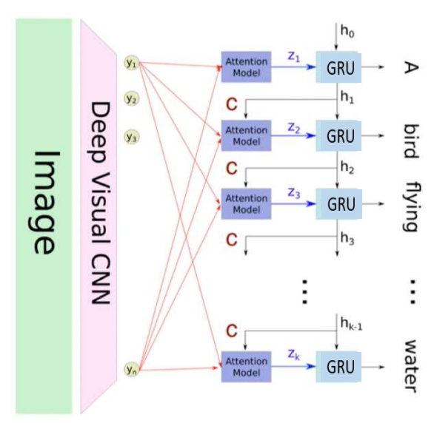
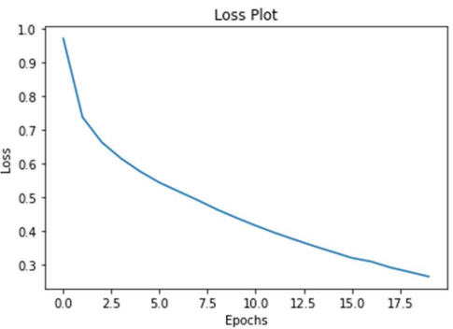
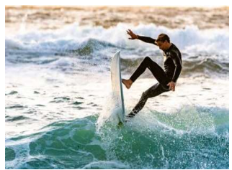
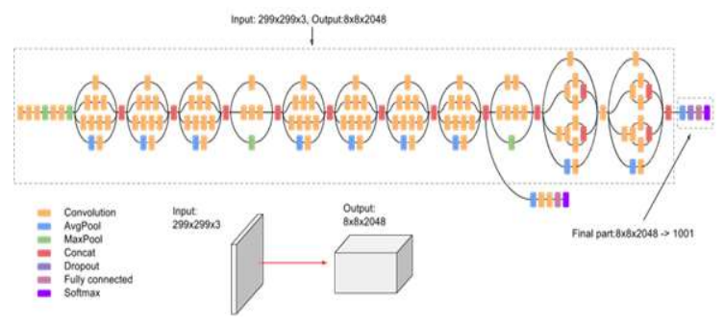
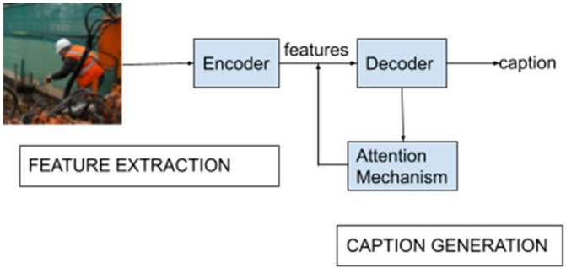
Image Caption Generator Using Attention Mechanism
Authors: Vaishnavi Agrawal, Shariva Dhekane, Neha Tuniya, Vibha Vyas
TM
Methodology
Generating captions for images is crucial for many conglomerates like Google to enhance the search experience by allowing users to search by images. Social media platforms like Facebook, Twitter, Instagram, and Snapchat also employ this kind of image captioning to help monitor which user likes what kind of posts. This system can be used for scene-to-text conversion for people with visual disabilities later converted to speech.
Results
Introduction
Proposed Model
For the encoder, Convolutional Neural Networks (CNN) will be used, as features are to be extracted from images. Pre-trained InceptionV3 is used as the CNN. Since InceptionV3 is an object-detection deep network, it needs to be tweaked a little to work as an encoder. To get a feature vector from this deep network, the final is removed and a feature vector of size (8x8x2048) is obtained. The feature vector extracted from this CNN will be fed to a Recurrent Neural Network (RNN). A Gated Recurrent Unit (GRU) is used as the RNN for decoding. Bahdanau attention is used as the attention mechanism, to generate more focused captions.
Fig. 4. Loss versus Epoch plot
Fig. 2. Overall model architecture
Predicted caption– a young man is on a surf board on a wave
Conclusion
The training data and the corresponding vocabulary was limited, the model might fail to identify objects from input scenes that do not feature in its vocabulary.
Fig. 3. Convolutional Neural Network architecture
Fig. 1. Flowchart for image caption generator.

